Slide 1
Programming with Python
Basic Concepts 1

Slide 2

Lesson Objectives
Introduction to Python
Variables
Operators
Loops
Conditional statements
Strings

Slide 3
Introduction to Python
Section 1

Slide 4


Introduction to Python
Python is a widely-used, interpreted, object-oriented, and high-level programming language with dynamic semantics, used for general-purpose programming
Python was created by Guido van Rossum, born in 1956 in Haarlem, the Netherlands
Notes:
Ngôn ngữ lập trình bậc cao, thông dịch, oop,
Được sử dụng rộng rãi
Guido van Rossum – 1956 – Hà Lan
Google từ năm 2005 đến năm 2012 và cho Dropbox đầu vào năm 2013.

Slide 5

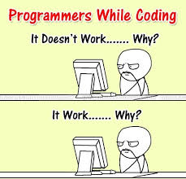
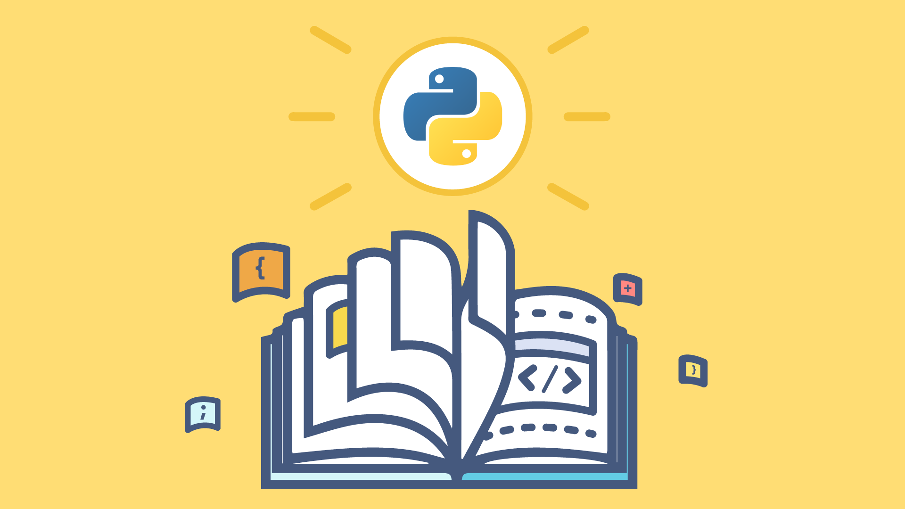
Introduction to Python
What makes Python special?
it's easy to learn
it's easy to teach
it's easy to use
it's easy to understand
it's easy to obtain, install and deploy
Notes:
thật dễ dàng để tải xuống, cài đặt và triển khai

Slide 6
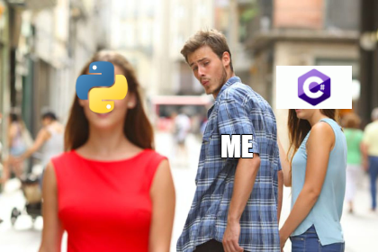
Introduction to Python
Drawbacks of Python
it's not a speed demon
debugging Python's code can be more difficult than with other languages
Some niches where Python is rarely seen
low-level programming
applications for mobile devices
Notes:
Ngách:
Mobile
Cấp thấp

Slide 7
Data types & Variables
Section 2

Slide 8
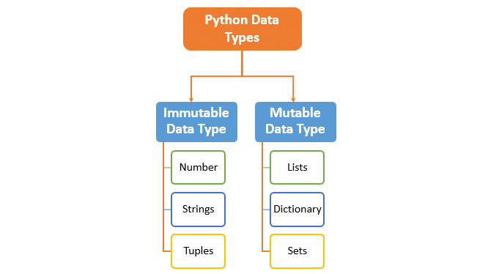
Data types
Notes:
Mutable Data Types: Data types in python where the value assigned to a variable can be changed
Immutable Data Types: Data types in python where the value assigned to a variable cannot be changed
Numbers: lưu trữ các giá trị số - Nó được sử dụng để thực hiện các phép toán thông thường.
Strings: lưu trữ thông tin dạng văn bản -

Slide 9
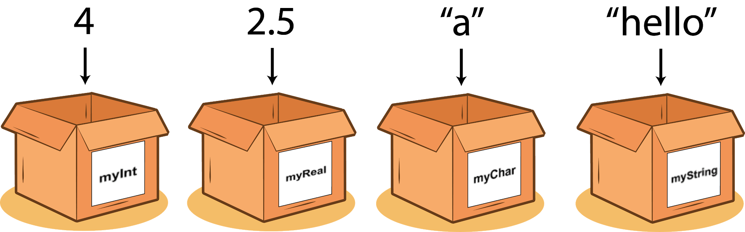
Variable
A variable is a named location reserved to store values in the memory
A variable is created or initialized automatically when you assign a value to it for the first time

Slide 10

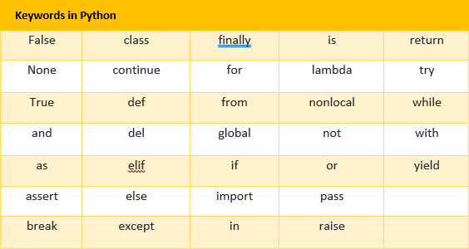

Variable Naming Rules
A legal identifier name must be:
a non-empty sequence of characters,
must begin with the underscore(_), or a letter,
cannot be a Python keyword.

Slide 11
Operators
Section 3

Slide 12
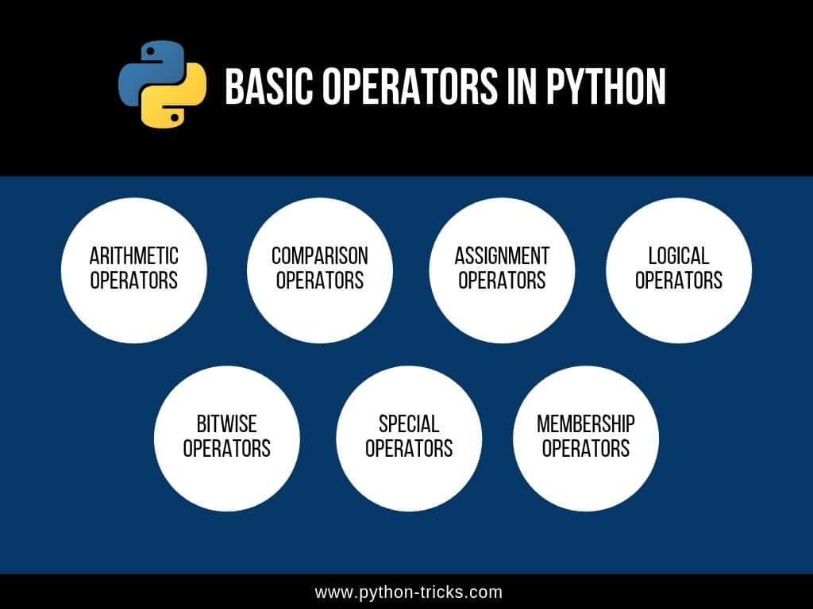
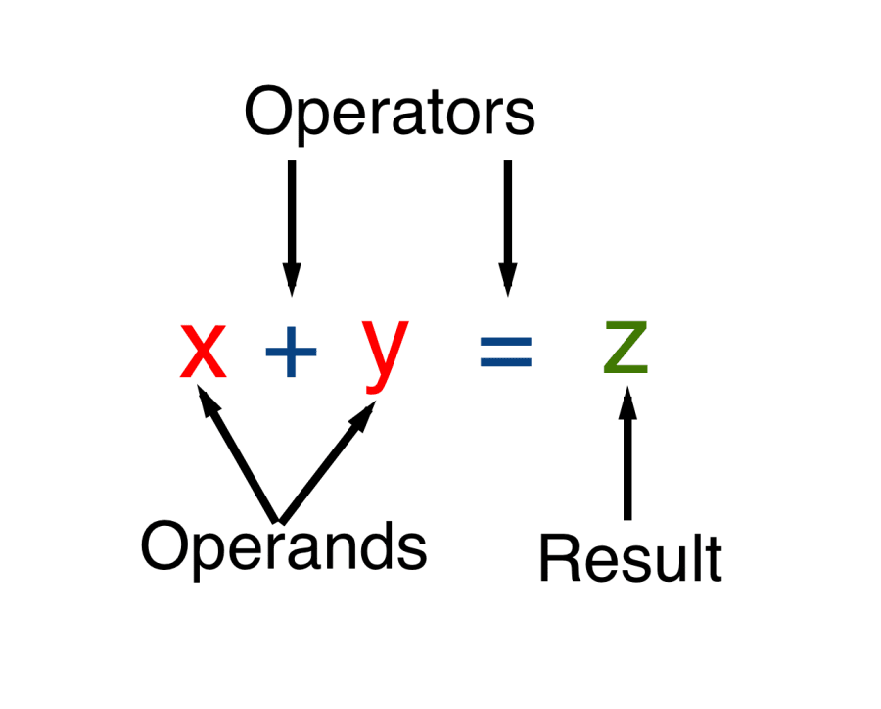
Operators - What is an operator?
An operator is a symbol of the programming language, which is able to operate on the values.
Basic Python operators: +, -, *, /, //, %, **

Slide 13
Operators - Arithmetic operators
MULTIPLICATION: An * (asterisk) sign is a multiplication operator.
DIVISION: A / (slash) sign is a divisional operator.
The value in front of the slash is a dividend, the value behind the slash, a divisor.
Remember:
The result produced by the division operator is always a float, regardless of whether or not the result seems to be a float at first glance: 1/2, or if it looks like a pure integer: 2/1.

Slide 14
Operators - Arithmetic operators
INTEGER DIVISION: An * (asterisk) sign is a multiplication operator.
It differs from the standard / operator in two details:
its result lacks the fractional part - it's absent (for integers), or is always equal to zero (for floats); this means that the results are always rounded;
it conforms to the integer vs. float rule.
Remember: rounding goes toward the lesser integer value (floor division)

Slide 15
Operators - Arithmetic operators
EXPONENTIATION: A ** (double asterisk) sign is an exponentiation (power) operator. Its left argument is the base, its right, the exponent
Remember:
when both ** arguments are integers, the result is an integer, too;
when at least one ** argument is a float, the result is a float, too.

Slide 16
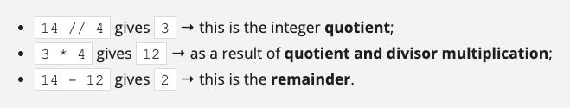
Operators - Arithmetic operators
REMAINDER (MODULO): The result of the % operator is a remainder left after the integer division.
ADDITION: The addition operator is the + (plus) sign, which is fully in line with mathematical standards.
SUBTRACTION: The subtraction operator is obviously the - (minus) sign, although you should note that this operator also has another meaning - it can change the sign of a number.

Slide 17
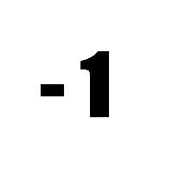
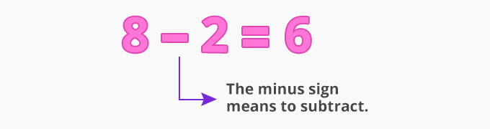
Operators - Unary vs binary operators
UNARY: Expects only one operand on the right side of the operator.
BINARY: Expects two operands on the left and right sides of the operator.

Slide 18
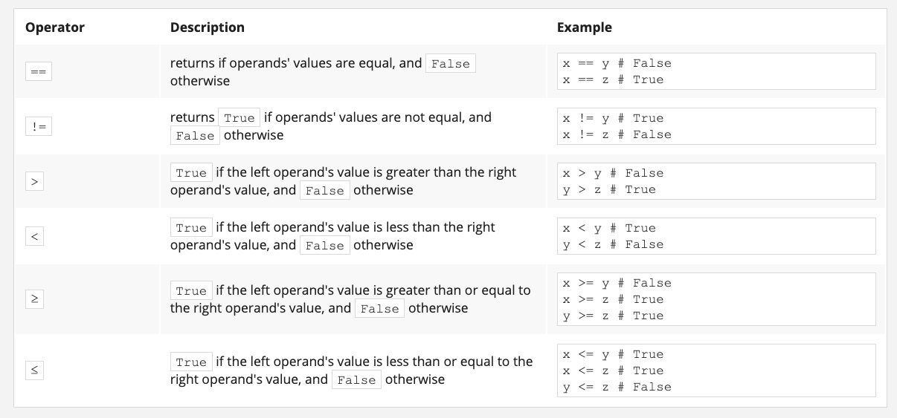
Operators - Comparison Operators

Slide 19
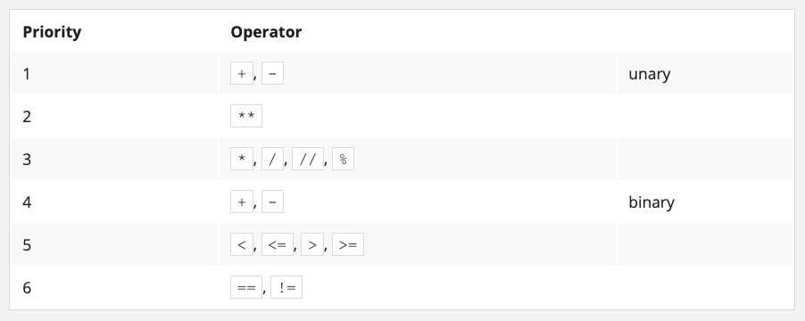
Operators - The hierarchy of priorities
Note: Subexpressions in parentheses are always calculated first.

Slide 20
Loops
Section 4

Slide 21
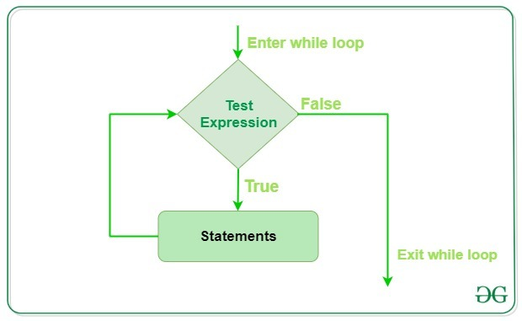
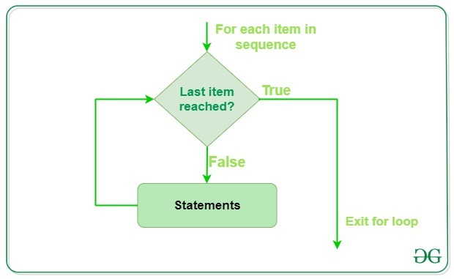
Loops

Slide 22
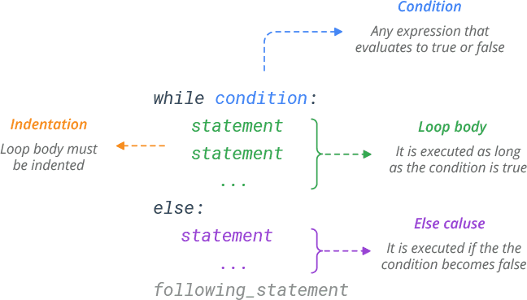
Loops - While
The while loop

Slide 23
Loops - While
If you want to execute more than one statement inside one while, you must (as with if) indent all the instructions in the same way;
An instruction or set of instructions executed inside the while loop is called the loop's body;
If the condition is False (equal to zero) as early as when it is tested for the first time, the body is not executed even once (note the analogy of not having to do anything if there is nothing to do);
The body should be able to change the condition's value, because if the condition is True at the beginning, the body might run continuously to infinity - notice that doing a thing usually decreases the number of things to do).

Slide 24
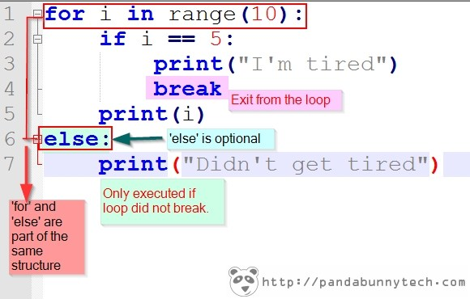
Loops - For
The for loop

Slide 25
Loops - break and continue
break - exits the loop immediately, and unconditionally ends the loop's operation; the program begins to execute the nearest instruction after the loop's body;
continue - behaves as if the program has suddenly reached the end of the body; the next turn is started and the condition expression is tested immediately.
Both these words are keywords.

Slide 26
Conditional statements
Section 5

Slide 27
Conditional execution
A mechanism which will allow you to do something if a condition is met, and not do it if it isn't
How does conditional statement work?
If the true_or_not expression represents the truth (i.e., its value is not equal to zero), the indented statement(s) will be executed;
if the true_or_not expression does not represent the truth (i.e., its value is equal to zero), the indented statement(s) will be omitted (ignored), and the next executed instruction will be the one after the original indentation level

Slide 28
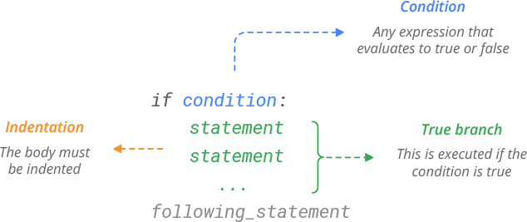
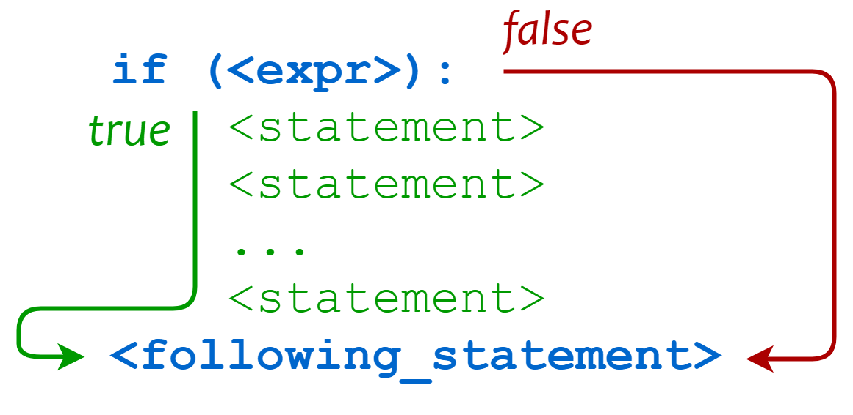

Conditional if statement

Slide 29
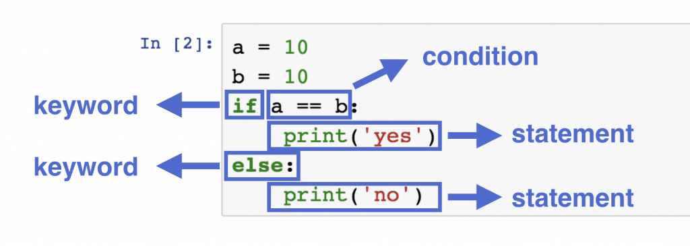
Conditional if else statement
The if-else execution goes as follows:
if the condition evaluates to True (its value is not equal to zero), the perform_if_condition_true statement is executed, and the conditional statement comes to an end;
if the condition evaluates to False (it is equal to zero), the perform_if_condition_false statement is executed, and the conditional statement comes to an end.

Slide 30
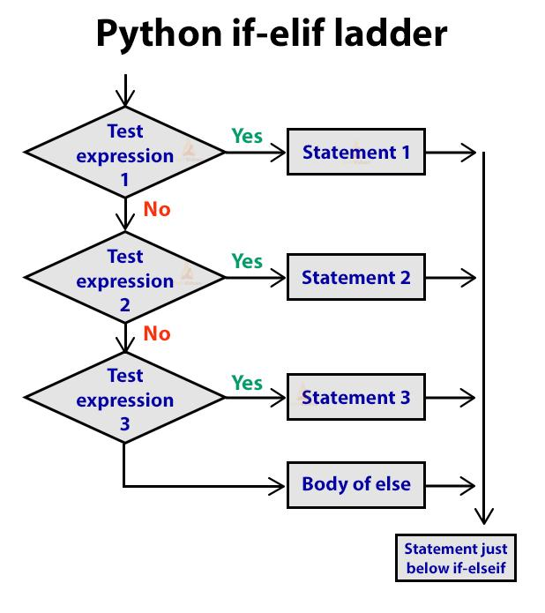
Conditional if elif else statement
elif is used to check more than just one condition, and to stop when the first statement which is true is found.
Some additional attention has to be paid in this case:
you mustn't use else without a preceding if;
else is always the last branch of the cascade, regardless of whether you've used elif or not;
else is an optional part of the cascade, and may be omitted;
if there is an else branch in the cascade, only one of all the branches is executed;
if there is no else branch, it's possible that none of the available branches is executed.

Slide 31
Strings
Section 6

Slide 32
Strings Operators
CONCATENATION
The + (plus) sign, when applied to two strings, becomes a concatenation operator
The concatenation operator is not commutative, i.e., "ab" + "ba" is not the same as "ba" + "ab"
REPLICATION
The * (asterisk) sign, when applied to a string and number (or a number and string, as it remains commutative in this position) becomes a replication operator

Slide 33
Strings
Convert a number into a string using str()
The print() function sends data to the console
The input() function gets data from the console
The result of the input() function is a string
Python methods demo in this notebook:
https://colab.research.google.com/drive/1HndehE-LIw33dANz_2kIuydmsivy6jsW

Slide 34
References
Main documents are used to develop this material
https://edube.org/study/pe1
https://python-tricks.com/
https://realpython.com/
https://www.w3schools.com/python/
Further reading documents
Guttag, John. Introduction to Computation and Programming Using Python: With Application to Understanding Data Second Edition. MIT Press, 2016. ISBN: 9780262529624.

Slide 35

Thank you

